Slide 1
Subtype Analysis
GeoMx DSP Project

Slide 2
Overall Subtype Primary
HER2-/HR+: 36
HER2-0: 4
HER2-Low Positive: 18
HER2 Unknown: 14
HER2+/HR-: 4
HER2+/HR+: 30
TNBC: 20
HER2-0: 12
HER2-Low Positive: 12
HER2 Unknown: 4

Slide 3
Overall Subtype Mets (with Primary Fallback)
HER2-/HR+: 40
HER2-0: 4
HER2-Low Positive: 16
HER2-Positive: 6
HER2 Unknown: 14
HER2+/HR-: 6
HER2+/HR+: 26
TNBC: 18
HER2-0: 12
HER2-Low Positive: 2
HER2 Unknown: 4

Slide 4
Changes in Primary to Mets Subtype
HER2+/HR+ → HER2-/HR+: 6 samples (3 pts)
HER2-/HR+ → HER2+/HR+: 2 samples (1 pt)
TNBC → HER2+/HR-: 2 samples (1 pt)

Slide 5
Changes in HER2 Status
HER2+ → HER2-low positive
2 samples (1 pt)
HER2+ → HER2-0
2 samples (1 pt)
HER2+ → Unknown/Not done
10 samples (5 pts)

Slide 6
Changes in HER2 Status
HER2-0 → HER2-low positive
4 samples (2 pts)
HER2-0 → Unknown/Not done
4 samples (2 pts)

Slide 7
Changes in HER2 Status
HER2-Low Positive → HER2+
4 samples (2 pts)
HER2-Low Positive → HER2-0
2 samples (1 pt)
HER2-Low Positive → Unknown/Not done
16 samples (8 pts)

Slide 8
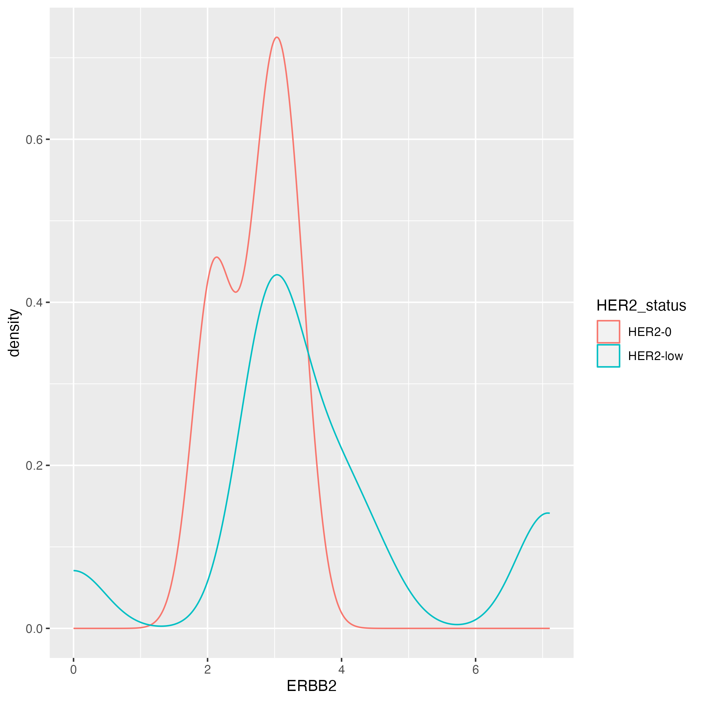
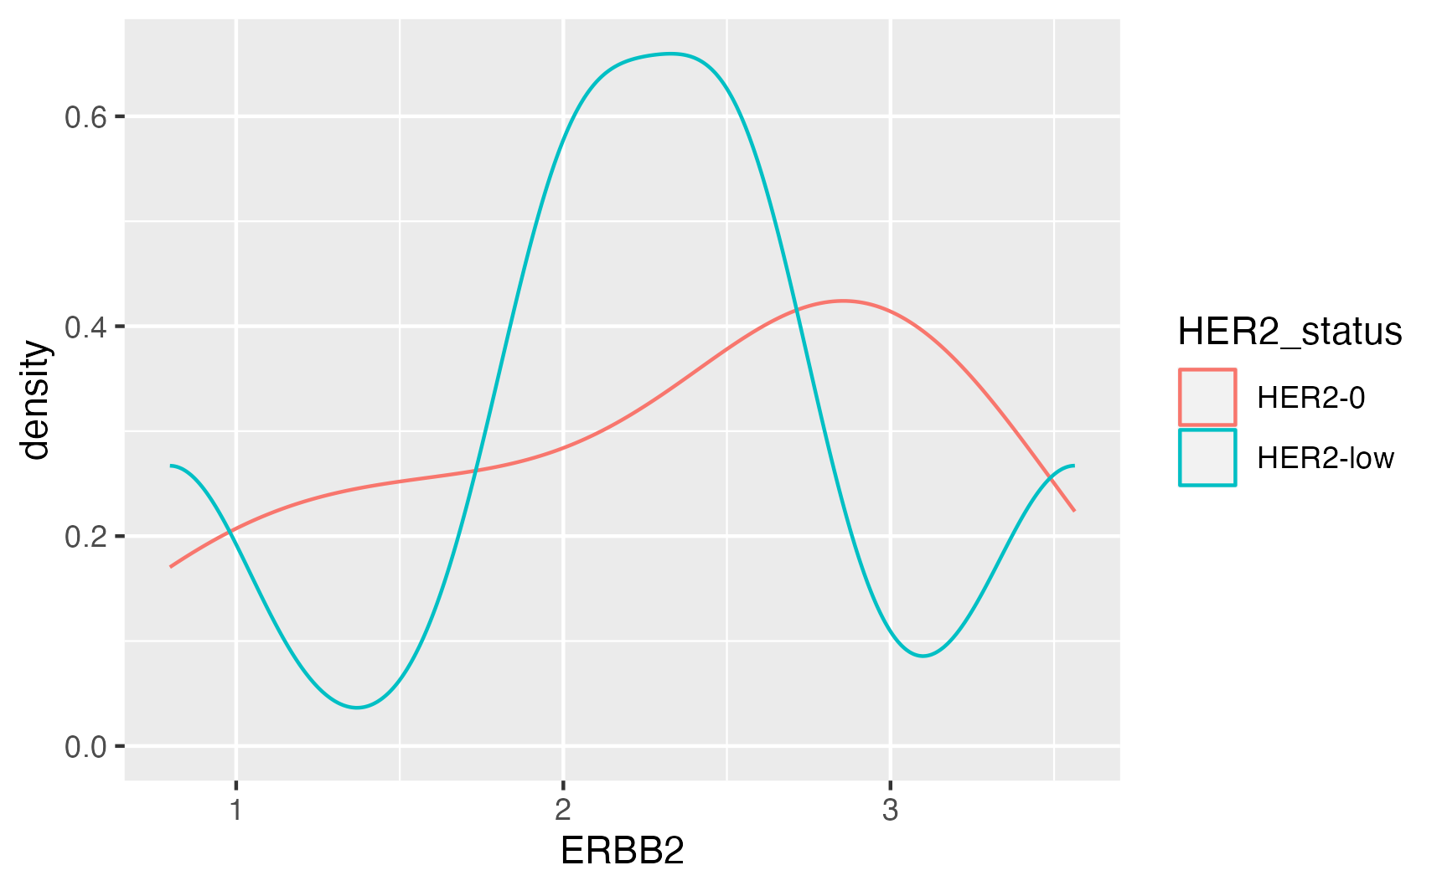
HER2 Primary Status in TNBC and HR+ immune AOI
TNBC
HER2-/HR+

Slide 9
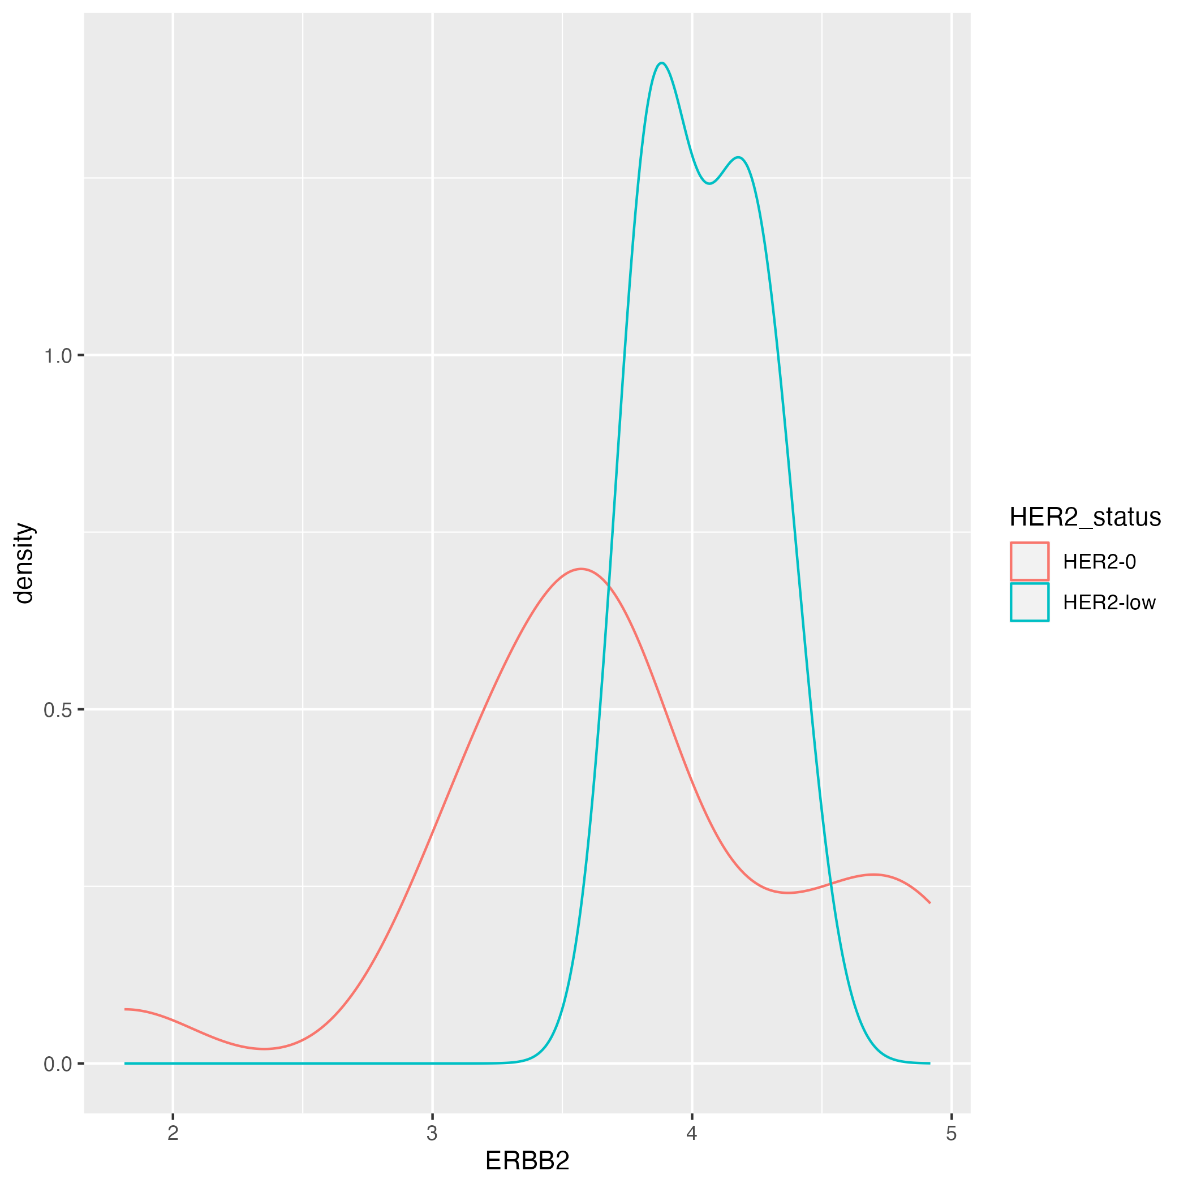
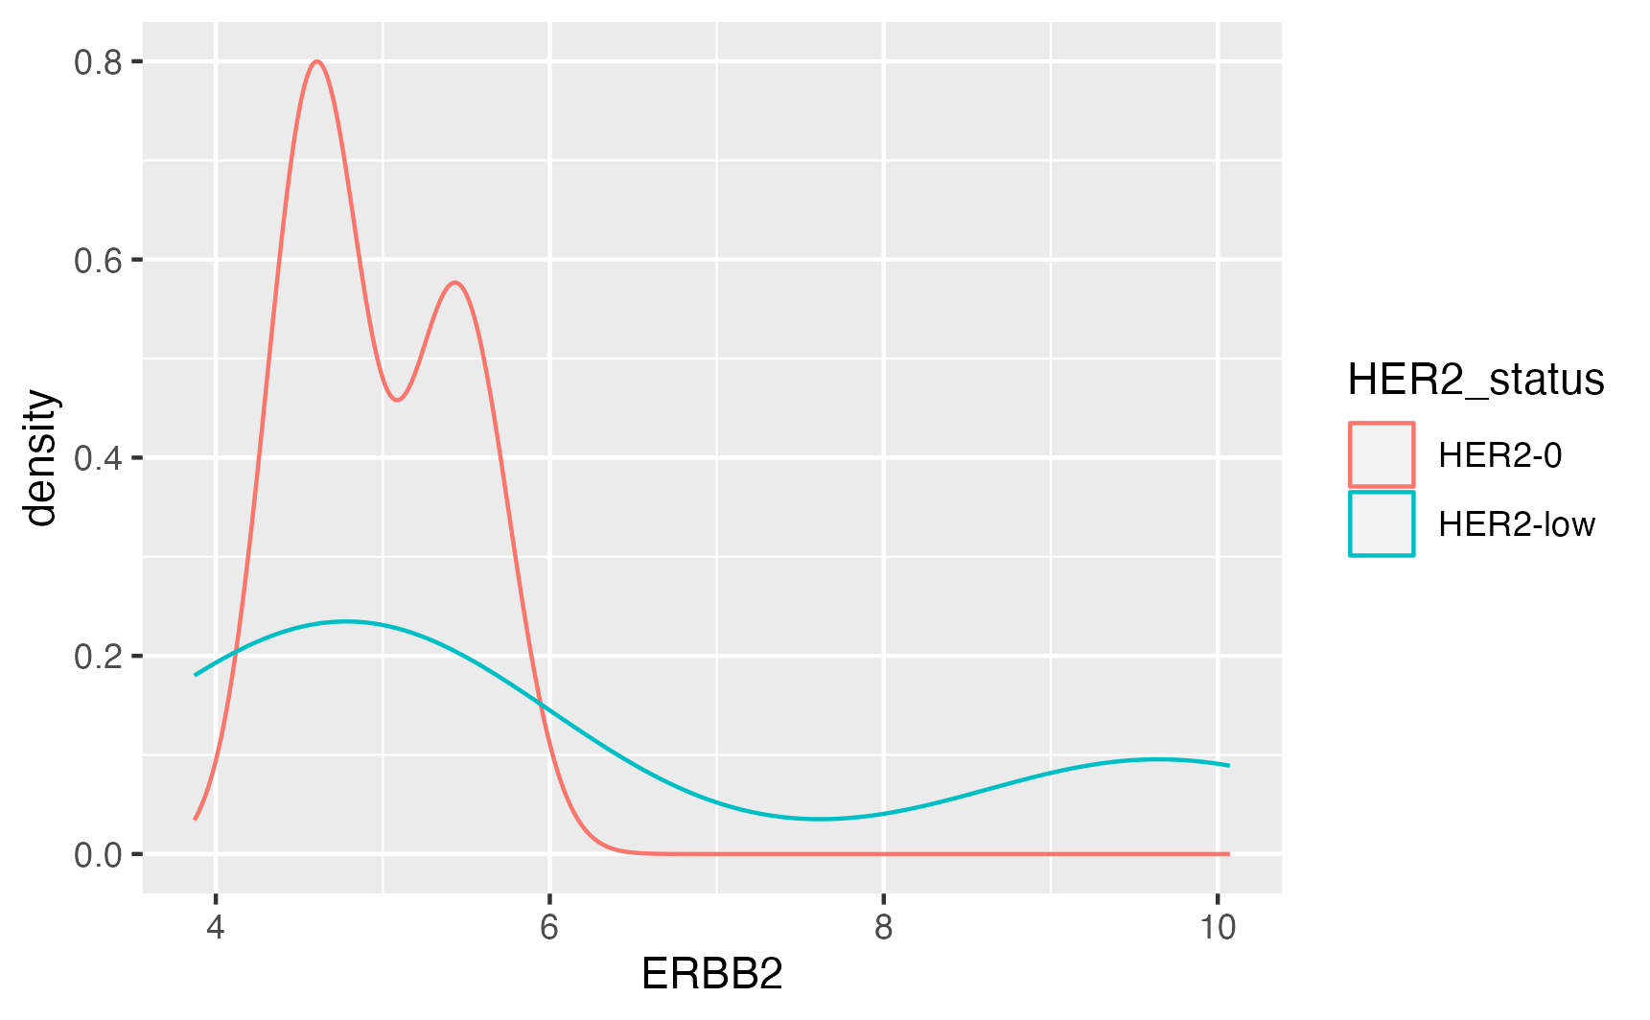
HER2 Primary Status in TNBC and HR+ tumor AOI
TNBC
HER2-/HR+

